Slide 1

Raising procedures in Institute of Fish Resources – Varna for the activities related to the National Data Collection Program in Bulgaria
Lidia Nedkova, IFR-Varna

Slide 2
TASKS
Bottom trawl survey and stock assessment of target species - turbot, spiny dogfish and whiting, and bycatch of thornback ray and other accompanying species off the Bulgarian Black Sea Sector: Province- structure raising
Biological monitoring (Biological samples collection) of the landed Rapana catch by the Bulgarian Fishing: Province- structure raising
Scientific research to estimate catch, bycatch, discarded and landed quantities, collect biological data on all species of fish and other marine organisms, and collect data on vulnerable, protected and endangered species, by observers on board fishing vessels, which carry out fishing activities in the Bulgarian Black Sea: Fleet- province-structure raising

Slide 3
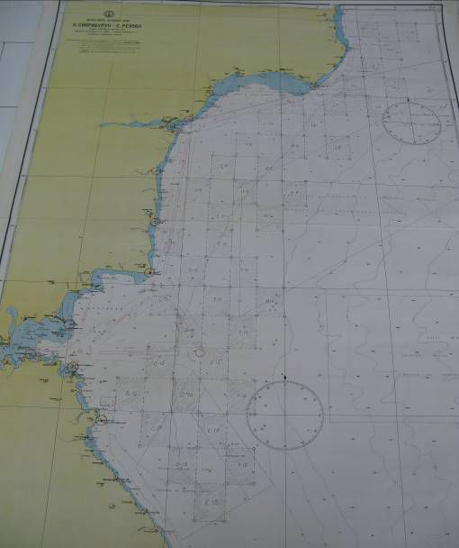
Sampling Scheme
Task 1
Standard methodology for stratified sampling; the survey area was segmented into four depth-based strata: Stratum 1 (15-35 m), Stratum 2 (35–50 m), Stratum 3 (50–75 m), and Stratum 4 (75–100 m).
Sampling was carried out in 40 randomly selected fields, each measuring 5′ latitude by 5′ longitude, covering an area of 62.58 km2. A total of 40 demersal trawls were conducted, with each trawl lasting 60 minutes at a speed between 2.2 and 2.6 knots.
Map of the Fields

Slide 4
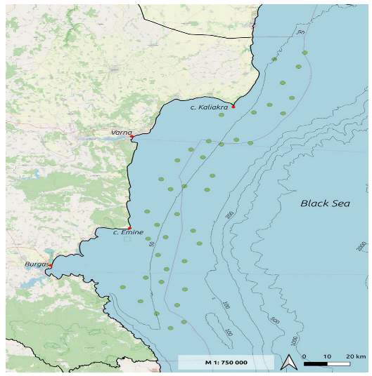
Sampling Scheme
Task 1
Bottom Trawling Activities – 2 seasonal surveys (Spring and Autumn)

Slide 5
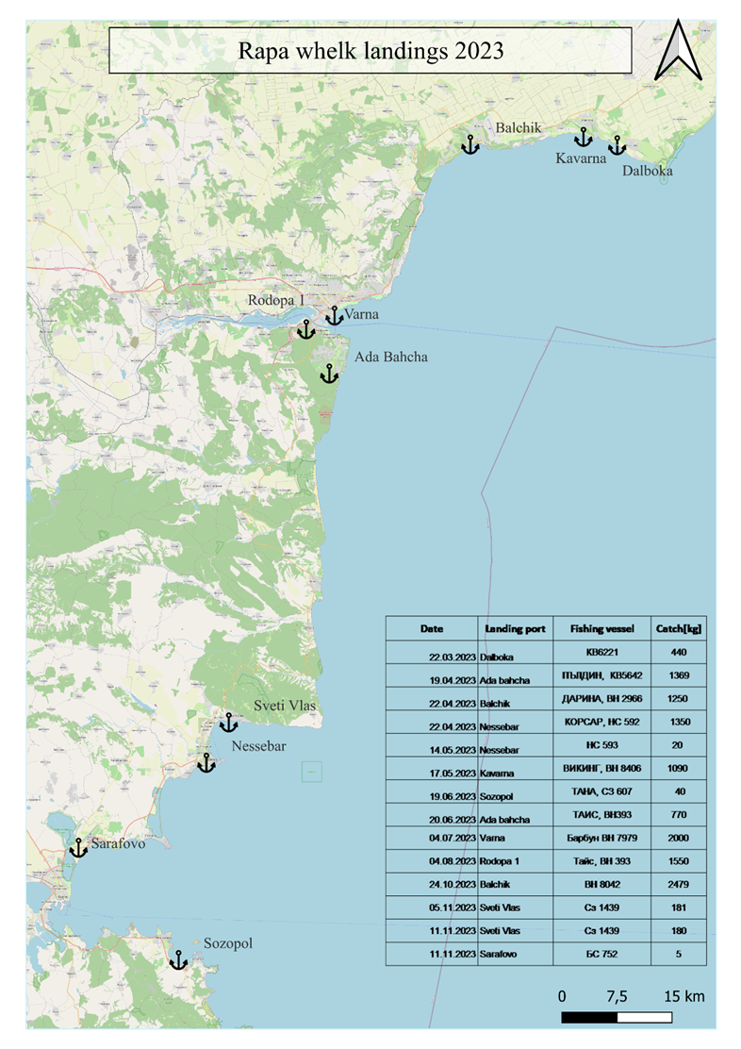
Sampling Scheme
Task 2
Annually, a minimum of 1200 samples, each containing 100 rapa whelk specimens, are randomly gathered from various ports along Bulgaria's northern and southern coastlines.
The following essential biological data is collected: the total mass of the target species landed at port, as well as the total weight (TW, g), shell length (SL, mm), shell width (Wd, mm), and aperture shell length (AL, mm).
Supplementary biological information is also recorded, including sex ratio, size and weight distribution by sex, sex ratio in relation to shell length and total weight, and gonadosomatic index (when applicable).

Slide 6
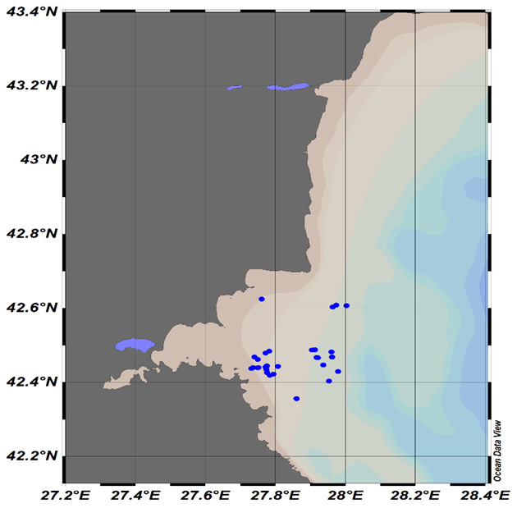
Sampling Scheme
Task 3
100 fishing days: 30 days gillnets (turbot); 30 days pelagic trawls (sprat, horse mackerel); 20 days beam trawls (R. venosa); 20 days polyvalent vessels (Rapana, horse mackerel, red mullet)
The sampling frame of the survey was the National Fleet Register. Within each of the strata (activities, fleet segments), the vessels were randomly selected for sampling.
Pelagic Trawl Observations

Slide 7
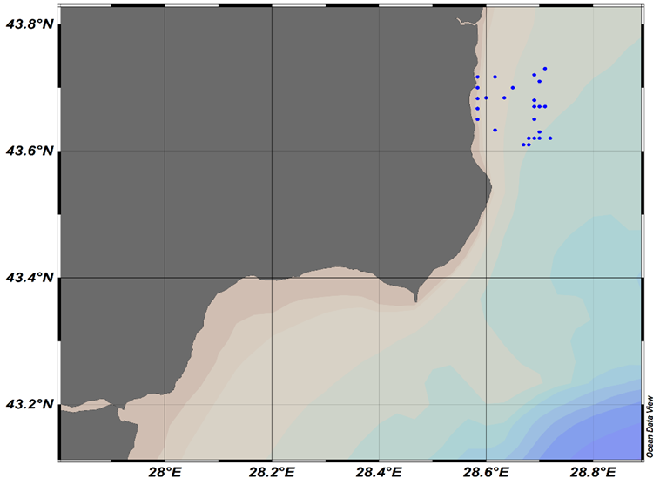
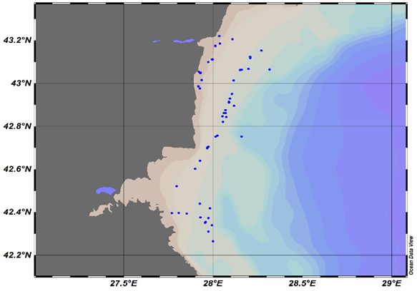
Sampling Scheme
Task 3
Gillnet Fishery Observations
Polyvalent Vessels Observations

Slide 8
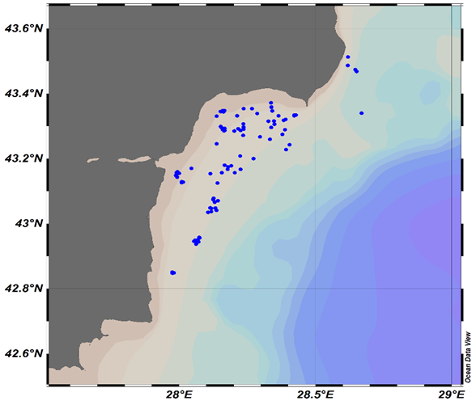
Sampling Scheme
Task 3
Beam Trawl Fishery Observations

Slide 9
Statistical Estimation Methodology
Task 1
Task 2
The swept area method was applied using the BioIndex program: R code to perform bottom trawl data analysis using the MEDITS file format, which enables the calculation of standardized biomass, abundance and length frequency distributions, sex ratio by size class.
Classical allometric models used to analyze the morphometric relationships between the biological parameters; The least-squares method used to estimate the linear-weight relationship (LWR): W=a*L^b;
The gonadosomatic index (GSI) is determined: GSI = [gonad weight/body weight] × 100;
The XLSTAT software and the statistical libraries of PYTHON, used to display the linear-weight histograms;

Slide 10
Statistical Estimation Methodology
Task 3
General statistical data on the quantities of priority species, bycatch (BC) weight, and BC rate, as well as the main biological parameters of total catch (TC) and BC, are usually presented.
The bycatch rate was calculated as the percentage of the total catch (FAO, 2019). The bycatch rates calculations are based on the weights of the TC and BC per fishing day. From the daily data, the calculations could be transferred to the annual level, taking into account the total weight of annual catches and total days at sea.
The coefficient of variation (CV, %) of BC is determined: CV = SD ∕ A × 100
Number of vulnerable species caught by fleet activities and segments was estimated based on FAO, 2019 b.
The bycatch ratio of vulnerable species (T, for species and segment of the fleet) is determined as: 𝑇 = 𝑁 / 𝐷, where – N, sum of the number of individuals of each species caught on each fishing day (ni) (𝑁 = Σ 𝑛𝑖𝑖), D - number of fishing days surveyed.

Slide 11
Collected Data
Task 1
Depth measured with an echo-sounder;
GPS coordinates of the starting and end points of trawling;
Trawling duration;
Abundance of fish species in trawls;
Weight of total catch in the trawl;
Absolute and standard length; weight of collected specimens;
Collection of otoliths for age determination;
Sex identification;
Bycatch species composition;
Stomachs for stomach content analysis of the reference species;
Measurement of small turbot specimens;
The target species:
turbot (Scophthalmus maximus);
spiny dogfish (Squalus acanthias), all gathered individuals will be measured;
whiting (Merlangius merlangus) - ichthyological samples taken from random hauls;
Bycatch species:
the thornback ray (Raja clavata);
European flounder (Platichthys flesus);
For all collected specimens of the target species - absolute and standard length, the weight of specimens, otoliths for age determination, selected turbot stomachs for stomach content analysis, and bycatch species composition;
For the other demersal species – weight, length measurements, sex.

Slide 12
Collected Data
Task 2
Data about the fishing vessels’ activity:
Fish expedition date;
Departure port;
Arrival port;
Fishing vessel name;
Vessel length (m);
Fishing gear;
Depth scale of the fishing activities;
Basic biological data:
Total weight of the target species, landed at a port;
Number of collected individuals in the biological sample;
Total weight of the individuals (TW, g);
Shell length(SL, mm),
Shell width (Wd, mm);
Aperture shell length (AL, mm).
Additional biological data:
Sex ratio,
sex maturity of collected individuals;
gonadosomatic index (when applicable);
Size and weight structure by sex,
sex ratio to shell length;
sex ratio to total weight.

Slide 13
Collected Data
Task 3
Data about the fishing vessels’ activity:
Geographic coordinates
Fish expedition data
Departure port
Arrival port
Fishing vessel name
Vessel type
Vessel length (m)
Fishing gear
Total number of fishing efforts per expedition
Depth scale of the fishing activities
Basic biological data
Total weight (kg) of by-catch of marine organisms
Weight (kg) of total catch (by-catch + main catch, TC)
Data on the size and weight structure of target catch and by-catch species
Data about vulnerable species – number, seizes, distribution by fleet segments and fishing activities, condition of animals (alive, injured, dead)
Data about sex and age structure.

Slide 14
Algorithms
Task 1
Task 2
On the shipboard, TL, SL and TW were measured;
The ages of the turbot and whiting were determined from otoliths in laboratory;
To determine the size-weight structure of the catches, the average, minimum, and maximum lengths and weights of individuals of both sexes were calculated, and the percentage distribution by size class (TL, cm) was determined.
Biometric parameters measured in laboratory: TW (g), BW (g), SL (mm), Wd (mm) and AL (mm); relationships between the individual biometric parameters were estimated;
Sex ratio and GSI were calculated;
The length-weight structure by sex, the ratio of the sexes to the shell length and the weight of the specimens were determined.

Slide 15
Algorithms
Task 3
Main catch of pelagic fish species:
Randomly collected samples containing ~200 specimens. Size- age structure was analyzed. TL was measured and placed into variation rows with class interval of 0.5 cm. Age was determined through otolith reading. The condition factor (K) was determined individually. Length-weight relationships and the parameters related to the von Bertalanffy equation were estimated.
Main catch of Rapa whelk with beam trawl:
Single samples of 100 specimens collected (from random catches). TW (g) and SL (cm) were measured for each specimen.
Main catch of expensive bottom fish species collected with gill nets:
The turbot specimens were measured (TL, cm and TW, g) on the board of fishing vessels.
Bycatch data in the investigated fisheries:
The collected samples of BC fishes are processed in laboratory, for estimations of lengths, weight, age and K.
Crustaceans and molluscs in the bycatch were identified and measured under laboratory conditions.
The length-weight relationships were determined (Log W = Loga + b*LogL).
The bycatch rate was calculated as the percentage of the total catch.

Slide 16

Evaluation of Method - Accuracy
Task 1
The obtained data was organized in MEDITS;
The R script in RoME and Biondex was used to analyze the MEDITS data;
The results are presented like maps and tables related to:
the surface of the researched square (Km2 , m2);
the average mass per unit area (g/m2 , t/Km2);
the mass limits variation per unit area;
the total biomass values (t);
the abundance index (individuals/km2);
Demersal expeditions for the assessment of turbot agglomerations provide additional information for the calculation of the CPUE (kg/hour) and CPUA (kg/m2 ) in the researched areas.

Slide 17
Evaluation of Method - Accuracy
Task 2
Bias and Error Analysis:
Data are checked for outliers using XLSTAT.
XLSTAT was used to display linear-weight histograms;
Summarized statistics of the measured biological parameters is presented;
The coefficient of variation (CV, %) is determined.

Slide 18


Evaluation of Method - Accuracy
Task 3
Bias and Error Analysis:
Data are checked for outliers.
Summarized statistics of the measured biological parameters is presented;
Linear-weight histograms;
The coefficient of variation (CV, %) is determined.
Precision and Repeatability:
Age reading for is performed by two people;
Comparative Studies Analysis:

Slide 19
Data Quality Control and Assurance
For All Tasks
IFR-Varna applies internal rules for Data Quality Control (DQC) and Data Quality Assurance (DQA) for laboratory studies, including all steps of marine data collection and analysis from sea expedition to final reporting.
The laboratory and sea protocols for each sample included a full description of all measurements. All biological data produced in a laboratory are completely documented and traceable back to its origin. The necessary documentation contain a description of sampling equipment and procedures, reference to standard operating procedures (SOP) for sample handling, and analytical procedures involved.
Data files are kept on several laptops. Technical and annual reports are prepared.

Slide 20
Thank You for your attention!

Slide 21
Reference List
Task 1
International bottom trawl survey in the Mediterranean Instruction manual. (2017) Version 9; Available at: https://www.sibm.it/MEDITS%202011/docs/Medits_Handbook_2017_version_9_5-60417r.pdf
Carbonara, P., & Follesa, M. C. (2019). Handbook on fish age determination: a Mediterranean experience. General fisheries commission for the mediterranean. Studies and Reviews, (98). Available at: 179.https://www.coispa.it/cms/archivio/download/ca2745en_HandbookonfishagedeterminationaMediterraneanexperience.pdf
European Commission: Joint Research Centre and Mannini, A.(2020),The JRC MEDITS R script – A tool to analyse MEDITS data during STECF EWGs, Publications Office; Available at: https://data.europa.eu/doi/10.2760/5799

Slide 22
Reference List
Task 2
ICES HQ, C. (2004). Report of the Workshop on Sampling and Calculation Methodology for Fisheries Data. (WKSCMFD) ICES Headquarters, Denmark. Available at: https://www.ices.dk/sites/pub/CM%20Doccuments/2004/ACFM/ACFM1204.pdf
ICES HQ, C. (2012). Report of the Study Group on Practical Implementation on Discard Sampling Plans. ICES Headquarters, Denmark. Available at: https://www.ices.dk/community/Documents/PGCCDBS/SGPIDS%202011.pdf
European Commission: Joint Research Centre and Mannini, A.(2020),The JRC MEDITS R script – A tool to analyse MEDITS data during STECF EWGs, Publications Office; Available at: https://data.europa.eu/doi/10.2760/5799
Shlyakhov, V. (ed.), (2013). MANUAL OF PROTOCOLS ON METHODS USED FOR ASSESSING FISH STOCKS IN THE BLACK SEA BY ANALYTIC METHODS BULGARIA, ROMANIA, TURKEY, UKRAINE. Available at: https://ifrvarna.com/images/files/ichtiol/Manual_of_analytic_methods_Black_Sea_project.pdf ;
Methodology for demersal research in the Bulgarian Black Sea waters, IFR – Varna; Available at: https://ifrvarna.com/images/files/ichtiol/Methodology_for_demersal_research_in_the_Bulgarian_Black_Sea_waters_L.pdf
Sparre, P. (2000). Manual on sample-based data collection for fisheries assessment: examples from Viet Nam Danish Institute for Fisheries Research Charlottenlund, Denmark. Available at: http://www.fao.org/3/x8923e/x8923e.pdf

Slide 23
Reference List
Task 3
Carpentieri, P. (2019). ‘Monitoring discards in Mediterranean and Black Sea fisheries: methodology for data collection’, FAO Fisheries and Aquaculture Technical Paper, Available at: http://www.fao.org/3/ca4914en/ca4914en.pdf
Carpentieri, P. (2019 b). ‘Monitoring the incidental catch of vulnerable species in Mediterranean and Black Sea fisheries Methodology for data collection’, FAO Fisheries and Aquaculture Technical Paper. Available at: http://www.fao.org/3/ca4991en/CA4991EN.pdf
Raykov, V. (ed.) Best practice guideline on scientific surveys and holistic methods in the Black Sea. Varna, Bulgaria: Institute of Oceanology “Fridtjof Nansen” Available at: https://www.ifrvarna.com/images/files/ichtiol/Best_guidlines_Black_Sea_project.pdf
Carpentieri, P., Bonanno, A., & Scarcella, G. (2020). ‘Technical guidelines for scientific surveys in the Mediterranean and the Black Sea. Procedures and sampling for demersal (bottom and beam) trawl surveys and pelagic acoustic surveys’, FAO Fisheries and Aquaculture Technical Paper, Available at: http://www.fao.org/3/ca8870en/CA8870EN.pdf

